Slide 1
COMP5423 Natural Language Processing

Slide 2
N-Gram Language Models

Slide 3
Outline
Learning Objectives
N-Gram Language Models
N-Grams
Smoothing Techniques
Out of Vocabulary (OOV) Problem

Slide 4
N-Gram Language Models
Introduction to Language Models
Next Word Prediction
Sentence Validation
Need a model to assign a probability to each possible next word based on previous words.
in
Please turn your homework _______
into
over
the
to
Need a model to assign a probability to a sequence of words (or a sentence).
(1) all of a sudden I notice three guys standing on the sidewalk.
(2) on guys all I of notice sidewalk three a sudden standing the.
Notes:
Word prediction is to guess the next word. It is an essential subtask of speech recognition, hand-writing recognition and spelling error detection, etc.
P30:
The same models will also serve to assign a probability to an entire sentence. Such a model, for example, could predict that the following sequence has a much higher probability of appearing in a text:
Why would you want to predict upcoming words, or assign probabilities to sentences? Probabilities are essential in any task in which we have to identify words in noisy, ambiguous input, like speech recognition or handwriting recognition.

Slide 5



N-Gram Language Models
Introduction to Language Models
Application in Speech Recognition
Application in Machine Translation
I will be back soonish.
I will be bassoon dish.
He introduced reporters to the main contents of the statement.
He briefed to reporters the main contents of the statement.
He briefed reporters on the main contents of the statement.
Notes:
Probabilities are essential in any task in which we have to identify words in noisy, ambiguous input, like speech recognition.
Assigning probabilities to sequences of words is also essential in machine translation.
A probabilistic model of word sequences could suggest that briefed reporters on is a more probable English phrase than briefed to reporters (which has an awkward to after briefed) or introduced reporters to (which uses a verb that is less fluent English in this context)

Slide 6

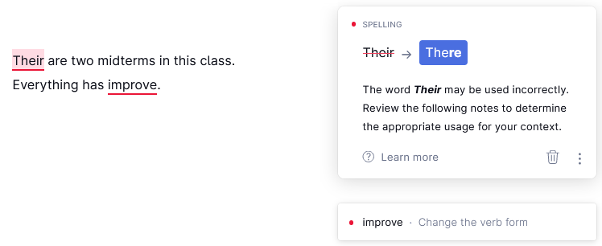
N-Gram Language Models
Introduction to Language Models
Application in Real-Word Spelling (Error) or Grammatical Error Correction
Their are two midterms in this class
There are two midterms in this class
Free Online Writing Assistant
Everything has improve
Everything has improved

Slide 7

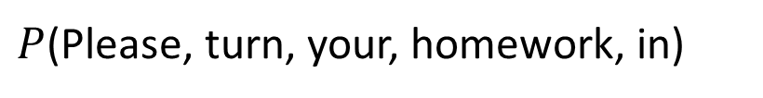

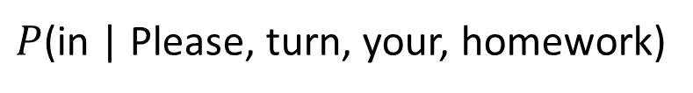
N-Gram Language Models
Introduction to Language Models
The model that computes the probability of a sequence of words or probability of an upcoming word is called a language model (LM).
$$P(w_{1},w_{2},...,w_{n−1},w_{n})$$
$P$(Please, turn, your, homework, in)
$$P(w_{n}{|w}_{1},w_{2},...,w_{n−1})$$
$P$(in | Please, turn, your, homework)
Next Word
Context or History
Notes:
One model of word predication is N-Gram model, which uses the previous N-1 words to predict the next one. Guessing the next word turns out to be closely related to another problem: computing the probability of a sequence of words.
P31:
In this chapter we introduce the simplest model that assigns probabilities LM to sentences and sequences of words, the N-gram. An N-gram is a sequence of N N-gram words: a 2-gram (or bigram) is a two-word sequence of words like “please turn”, “turn your”, or ”your homework”, and a 3-gram (or trigram) is a three-word sequence of words like “please turn your”, or “turn your homework”.

Slide 8

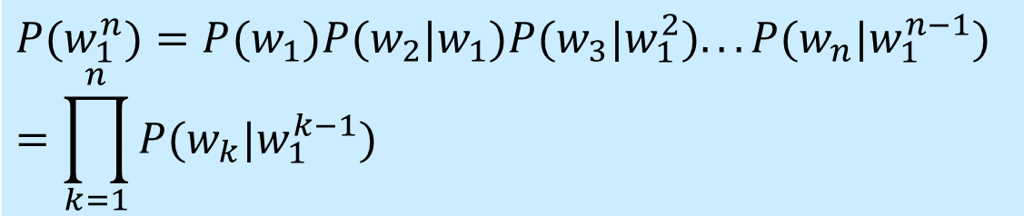

N-Gram Language Models
Introduction to Language Models
If we denote the word sequence as $w1$, $w2$, …, $wn$, then the probability of word sequence can be represented by:
We then use the chain rule of probability to decompose this probability.
$$P(w_{1},w_{2},...,w_{n−1},w_{n})=P(w_{1}^{n})$$
$$P(w_{1}^{n})=P(w_{1})P(w_{2}|w_{1})P(w_{3}|w_{1}^{2})...P(w_{n}|w_{1}^{n−1}) \\ =\prod_{k=1}^{n}{P(w_{k}|w_{1}^{k−1})}$$
Joint Probability
We can estimate the joint probability of an entire sequence of words by multiplying together a number of conditional probabilities.
Conditional Probability
Notes:
Multiplication [ˌmʌltɪplɪˈkeɪʃ(ə)n]
P32:
As we said above, we can’t just estimate by counting the number of times every word occurs following every long string, because language is creative and any particular context might have never occurred before!
The intuition of the n-gram model is that instead of computing the probability of a word given its entire history, we can approximate the history by just the last few words.

Slide 9


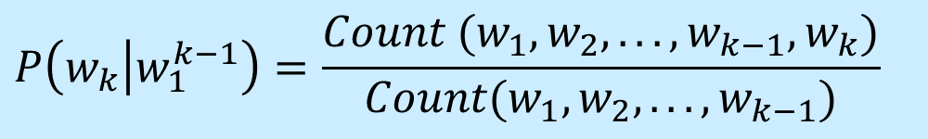
N-Gram Language Models
Introduction to Language Models
Question: How can we compute the probabilities like ?
We don’t know any way to compute the exact probability of a word given a long sequence of preceding words.
$$P\left(w_{k} | w_{1}^{k−1}\right)$$
Too many possible sentences! We’ll never see enough data for estimating these.
$$P\left(w_{k} | w_{1}^{k−1}\right)=\frac{Count (w_{1},w_{2},...,w_{k−1},w_{k})}{Count(w_{1},w_{2},...,w_{k−1})}$$
Notes:
P39:
The chain rule shows the link between computing the joint probability of a sequence and computing the conditional probability of a word given previous words.
Equation 3.4 suggests that we could estimate the joint probability of an entire sequence of words by multiplying together a number of conditional probabilities. But using the chain rule doesn’t really seem to help us! We don’t know any way to compute the exact probability of a word given a long sequence of preceding words.

Slide 10



N-Gram Language Models
N-Gram Models
We solve this problem by making a simplification to approximate the probability of a word given all the previous words by conditional probability of the preceding one word or a two words .
$$P(w_{k}|w_{1}^{k−1})$$
$$P(w_{k}|w_{k−1})$$
$$P(w_{k}|w_{k−2},w_{k−1})$$
Bi-Gram Model
Tri-Gram Model
Entire history → Last Few Words
$P$(in | Please, turn, your, homework) ≈ $P$(in | homework)
The assumption that the probability of a word depends only on the previous word(s) is called Markov Assumption.
Notes:
P32:
The intuition of the N-gram model is that instead of computing the probability of a word given its entire history, we can approximate the history by just the last few words.
The bigram model, for example, approximates the probability of a word given all the previous words by using only the conditional probability of the preceding word.

Slide 11
N-Gram Language Models
N-Gram Models
An N-Gram is a sequence of N words.
Bi-Gram (2-Gram): A Two-word Sequence
Tri-Gram (3-Gram): A Three-word Sequence
N-Gram model is the simplest model that assigns the probability to sentences or sequences of words.
More sophisticated language models are neural network language models.
Please turn, turn your, your homework, …
Please turn your, turn your homework, …
From probabilities over words to probabilities over word embeddings.
Notes:
Chapter 3, P2:
In this chapter we introduce the simplest model that assigns probabilities LM to sentences and sequences of words, the N-gram. An N-gram is a sequence of N words: a 2-gram (or bigram) is a two-word sequence of words like “please turn”, “turn your”, or ”your homework”, and a 3-gram (or trigram) is a three-word sequence of words like “please turn your”, or “turn your homework”.

Slide 12
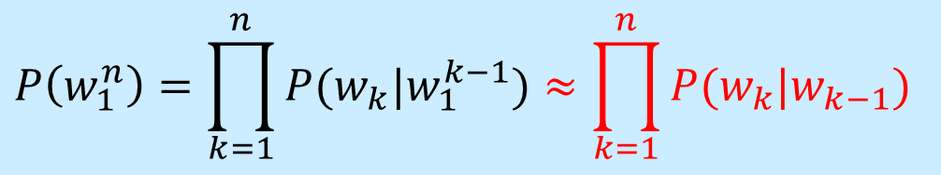
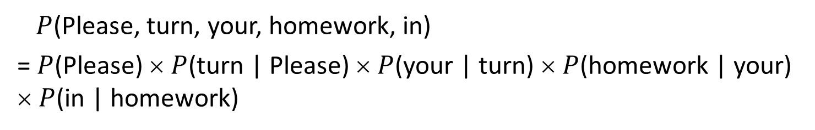
N-Gram Language Models
Bi-Gram Models
For a Bi-gram model, we compute the probability of a complete word sequence by conditioning on the previous word:
Question: How do we estimate these Bi-gram probabilities?
$$P\left(w_{1}^{n}\right)=\prod_{k=1}^{n}{P(w_{k}|w_{1}^{k−1})}≈\prod_{k=1}^{n}{P(w_{k}|w_{k−1})}$$
$P$(Please, turn, your, homework, in)
= $P$(Please) × $P$(turn | Please) × $P$(your | turn) × $P$(homework | your) × $P$(in | homework)
Notes:
P40:
How do we estimate these bigram or N-gram probabilities? An intuitive way to estimate probabilities is called maximum likelihood estimation or MLE. We get the MLE estimate for the parameters of an n-gram model by getting counts from a corpus, and normalizing the counts so that they lie between 0 and 1. For probabilistic models, normalizing means dividing by some total count so that the resulting probabilities fall legally between 0 and 1.

Slide 13
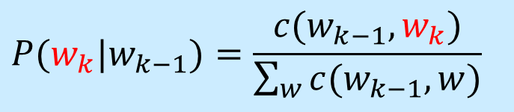
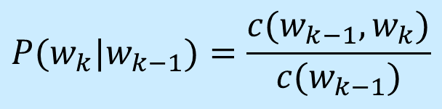
N-Gram Language Models
Bi-Gram Models
Maximum Likelihood Estimation (MLE)
$$P(w_{k}|w_{k−1})=\frac{c(w_{k−1},w_{k})}{\sum_{w}{c(w_{k−1},w)}}$$
We get these counts from the corpus (i.e., a collection of written texts).
Bi-Gram
Count
$$P(w_{k}|w_{k−1})=\frac{c(w_{k−1},w_{k})}{c(w_{k−1})}$$
Uni-Gram
Count

Slide 14
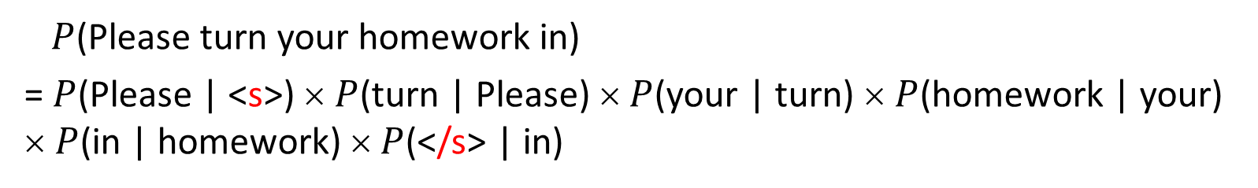
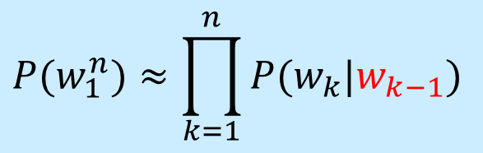
N-Gram Language Models
Bi-Gram Models
We often augment each sentence with a special symbol <s> at the beginning of the sentence, to give us the Bi-gram context of the first word. We’ll also need a special end-symbol </s>.
<s> and </s> are pseudo-words.
$$P(w_{1}^{n})≈\prod_{k=1}^{n}{P(w_{k}|w_{k−1})}$$
$P$(Please turn your homework in)
= $P$(Please | <s>) × $P$(turn | Please) × $P$(your | turn) × $P$(homework | your) × $P$(in | homework) × $P$(</s> | in)

Slide 15
N-Gram Language Models
Bi-Gram Models
Maximum Likelihood Estimation (MLE)
<s> I am Sam </s>
<s> Sam I am </s>
<s> I do not like green eggs and ham </s>
$$P\left(I | <s>\right)=\frac{2}{3}=0.67, P\left(Sam | <s>\right)=\frac{1}{3}=0.33, P\left(am | I\right)=\frac{2}{3}=0.67$$
$$P(</s>|Sam)=\frac{1}{2}=0.5, P\left(Sam | am\right)=\frac{1}{2}=0.5, P\left(do | I\right)=\frac{1}{3}=0.33$$
Notes:
P34:
Let’s work through an example using a mini-corpus of three sentences. We’ll first need to augment each sentence with a special symbol <s> at the beginning of the sentence, to give us the bigram context of the first word.

Slide 16
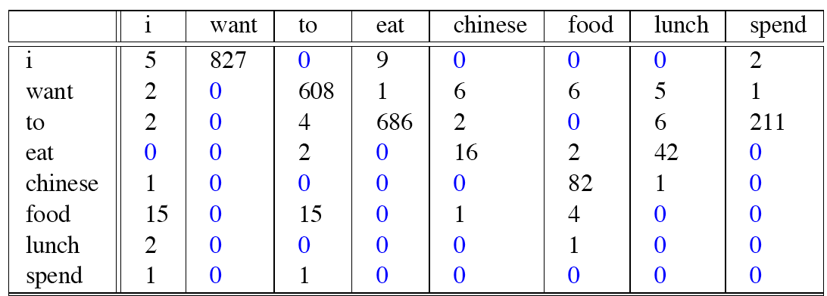


N-Gram Language Models
Bi-Gram Models
Bi-gram Count
Uni-gram Count
$$c(w_{k−1},w_{k})$$
Bigram Counts for Eight of the Words (Out of V=1446) in the Berkeley Restaurant Project Corpus of 9332 Sentences.
$$c(w_{k−1})$$
Notes:
P35:
Bigram counts for eight of the words (out of V = 1446) in the Berkeley Restaurant Project corpus of 9332 sentences. Zero counts are in gray.

Slide 17
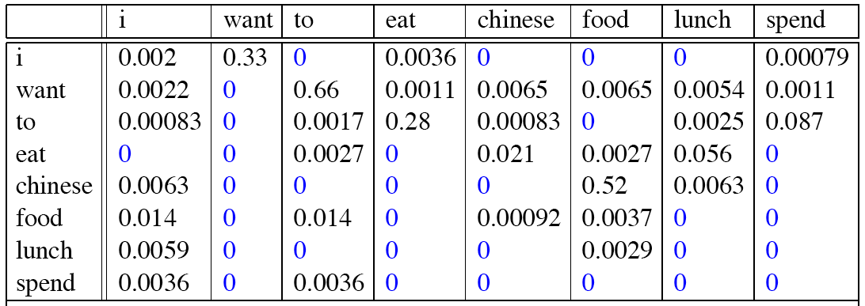

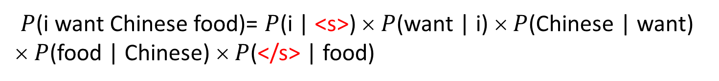
N-Gram Language Models
Bi-Gram Models
Bi-gram Probability
$$P(w_{k}|w_{k−1})$$
$P$(i want Chinese food)= $P$(i | <s>) × $P$(want | i) × $P$(Chinese | want) × $P$(food | Chinese) × $P$(</s> | food)

Slide 18

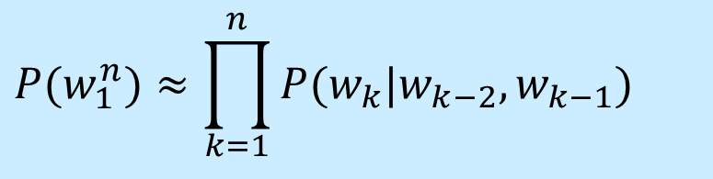
N-Gram Language Models
Tri-Gram Models
Similarly, a Tri-gram model approximates the probability of a word given all the previous words by conditional probability of two preceding words.
We can generalize the Bi-gram to the Tri-gram and thus to the N-gram.
$P(w_{k}|w_{1}^{k−1})$ $≈P(w_{k}|w_{k−2},w_{k−1})$
$$P(w_{1}^{n})≈\prod_{k=1}^{n}{P(w_{k}|w_{k−2},w_{k−1})}$$
Notes:
P35:
Although for pedagogical purposes we have only described bigram models, in practice it’s more common to use trigram models, which condition on the previous two words rather than the previous word, or 4-gram or even 5-gram models, when there is sufficient training data.
Note that for these larger ngrams, we’ll need to assume extra context for the contexts to the left and right of the sentence end. For example, to compute trigram probabilities at the very beginning of the sentence, we can use two pseudo-words for the first trigram (i.e., P(I|<s><s>).

Slide 19

N-Gram Language Models
Evaluation of Language Models
Training and Test
As a statistical model, the probabilities of an N-gram model come from the training corpus (training data).
The quality of an N-gram model is measured by its performance on some unseen data, called test corpus (test data).
The better model will assign a higher probability to the test data.
Training
Data
N-Gram
Model
Test Data
Training
Evaluation
Notes:
P43:
As with many of the statistical models in our field, the probabilities of an n-gram model come from the corpus it is trained on, the training set or training corpus. We can then measure the quality of an n-gram model by its performance on some unseen data called the test set or test corpus.

Slide 20
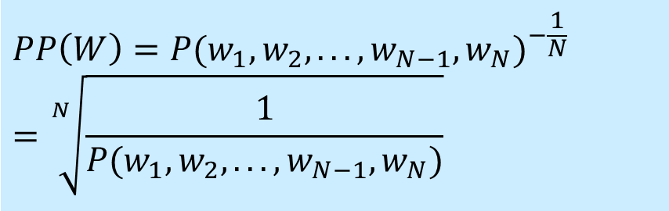


N-Gram Language Models
Evaluation of Language Models
Perplexity
The perplexity of a language model on a test dataset is the inverse probability of the test set, normalized by the number of words.
Geometric Mean
$$PP\left(W\right)={P(w_{1},w_{2},...,w_{N−1},w_{N})}^{−\frac{1}{N}}=\sqrt[N]{\frac{1}{P(w_{1},w_{2},...,w_{N−1},w_{N})}}$$
Bi-Gram Language Model
Chain Rule
$$PP\left(W\right)=\sqrt[N]{\prod_{k=1}^{N}{\frac{1}{P(w_{k}|w_{1}^{k−1})}}}$$
$$PP\left(W\right)≈\sqrt[N]{\prod_{k=1}^{N}{\frac{1}{P(w_{k}|w_{k−1})}}}$$
Notes:
P44:
We can use the chain rule to expand the probability of W:
Thus, if we are computing the perplexity of W with a bigram language model, we get:
The higher the conditional probability of the word sequence, the lower the perplexity.
N root of …
Since this sequence will cross many sentence boundaries, we need to include the begin- and end-sentence markers <s> and </s> in the probability computation. We also need to include the end-of-sentence marker </s> (but not the beginning-of-sentence marker <s>) in the total count of word tokens N.

Slide 21
N-Gram Language Models
Lower Perplexity = Better Model
Question 1: Which model is better and what are the reason behind?
Question 2: Are Tri-gram models always better than Uni-Gram and Bi-Gram Models?
The higher the probability of the word sequence, the lower the perplexity.
Train N-grams on 38 million words from WSJ and test on 1.5 million words (19,979 word vocabulary).
 | Uni-Gram | Bi-Gram | Tri-Gram
Perplexity | 962 | 170 | 109
The more information the N-gram gives us about the word sequence, the lower the perplexity.
Notes:
P44:
Since this sequence will cross many sentence boundaries, we need to include the begin- and end-sentence markers <s> and </s> in the probability computation. We also need to include the end-of-sentence marker </s> (but not the beginning-of-sentence marker <s>) in the total count of word tokens N.

Slide 22
N-Gram Language Models
Data Sparseness Problem and N-Gram Model Smoothing
Some perfectly acceptable N-grams are missing, because of finite training corpus.
Training Corpus
Test Corpus
… denied the allegations
… denied the reports
… denied the claims
… denied the request
… denied the offer
… denied the loan
A major problem with Tri-gram (even Bi-gram) models is sparse data, i.e., when we collect relevant statistics from the training corpus and apply it to a new given word sequence, there are Tri-grams never appeared in the training corpus.
Notes:
P45:
For any N-gram that occurred a sufficient number of times, we might have a good estimate of its probability. But because any corpus is limited, some perfectly acceptable English word sequences are bound to be missing from it. That is, we’ll have many cases of putative “zero probability N-grams” that should really have some non-zero probability.
P40:
because any corpus is limited, some perfectly acceptable English word sequences are bound to be missing from it.

Slide 23


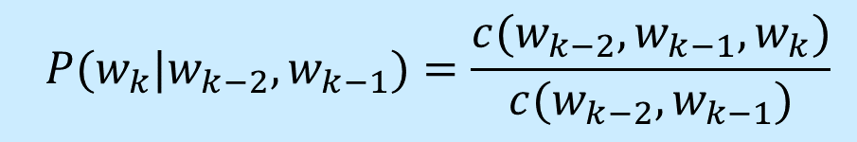
N-Gram Language Models
Data Sparseness Problem and N-Gram Model Smoothing
This will have the result:
Zero Probability
$$P(w_{k}|w_{k−2},w_{k−1})=\frac{c(w_{k−2},w_{k−1},w_{k})}{c(w_{k−2},w_{k−1})}$$
$= 0$
$$P\left(offer \right| denied, the) =0$$
Solution: To keep a language model from assigning zero probability to these unseen events, we’ll have to shave off a bit of probability mass from some more frequent events and give it to the events we’ve never seen.
This modification is called smoothing or discounting.
Notes:
P:
What do we do with words that are in our vocabulary (they are not unknown words) but appear in a test set in an unseen context (for example they appear after a word they never appeared after in training)? To keep a language model from assigning zero probability to these unseen events, we’ll have to shave off a bit of probability mass from some more frequent events and give it to the events we’ve never seen.

Slide 24
N-Gram Language Models
Data Sparseness Problem and N-Gram Model Smoothing
The Intuition of Smoothing: Steal Probability Mass to Generalize Better
P(w|denied the)
3 allegations
2 reports
1 claims
1 request
7 total
allegations
attack
man
reports
outcome
…
claims
request
P(w|denied the)
2.5 allegations
1.5 reports
0.5 claims
0.5 request
2 Others
7 total
allegations
allegations
attack
man
outcome
reports
…
claims
request
Notes:
[ˌæləˈɡeɪʃ(ə)n]

Slide 25

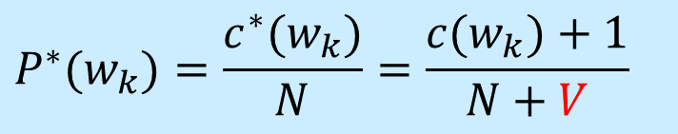
N-Gram Language Models
Add-One (Laplace) Smoothing
One simple way to do smoothing is just to add 1 to all the N-Gram counts.
(Un-Smoothed) Uni-gram Probability
$$P(w_{k})=\frac{c(w_{k})}{N}$$
N is the total number of words in the training corpus.
Add-One Smoothed Uni-gram Probability
$$P^{∗}(w_{k})=\frac{c^{∗}(w_{k})}{N}=\frac{c(w_{k})+1}{N+V}$$
V is the total number of words in the language (vocabulary size).
Notes:
P42:
To keep a language model from assigning zero probability to these unseen events, we’ll have to shave off a bit of probability mass from some more frequent events and give it to the events we’ve never seen. smoothing This modification is called smoothing or discounting.
The simplest way to do smoothing is to add one to all the bigram counts, before we normalize them into probabilities.
Since there are V words in the vocabulary and each one was incremented, we also need to adjust the denominator to take into account the extra V observations.

Slide 26
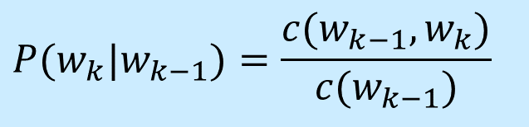
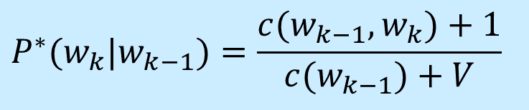
N-Gram Language Models
Add-One (Laplace) Smoothing
(Un-Smoothed) Bi-gram Probability
$$P(w_{k}|w_{k−1})=\frac{c(w_{k−1},w_{k})}{c(w_{k−1})}$$
Add-One Smoothed Bi-gram Probability
$$P^{∗}(w_{k}|w_{k−1})=\frac{c(w_{k−1},w_{k})+1}{c(w_{k−1})+V}$$

Slide 27
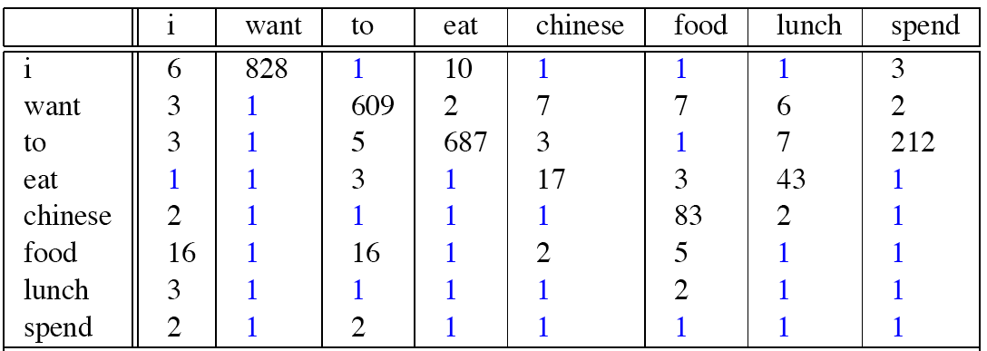

N-Gram Language Models
Add-One (Laplace) Smoothing
Add-One Bi-Gram Count
$$c(w_{k−1},w_{k})+1$$
Compared with Bi-Gram Count
Notes:
P51:
Add-one smoothed bigram counts for eight of the words (out of V = 1446) in the Berkeley Restaurant Project corpus of 9332 sentences. Previously-zero counts are in blue.

Slide 28
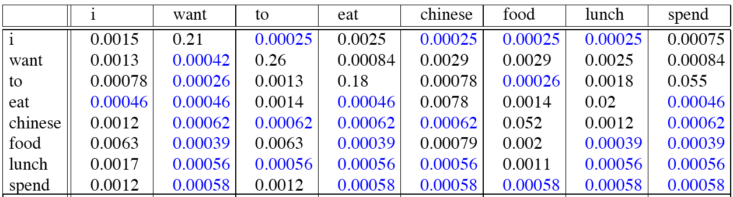

N-Gram Language Models
Add-One (Laplace) Smoothing
Add-one Smoothed Bi-Gram Probability
$$P^{∗}(w_{k}|w_{k−1})$$
Compared with Bi-Gram Probability
Notes:
P51:
Add-one smoothed bigram probabilities for eight of the words (out of V = 1446) in the BeRP corpus of 9332 sentences. Previously-zero probabilities are in gray.
Note that add-one smoothing has made a very big change to the counts. C(want to) changed from 609 to 238! We can see this in probability space as well: P(tojwant) decreases from .66 in the unsmoothed case to .26 in the smoothed case. … The sharp change in counts and probabilities occurs because too much probability mass is moved to all the zeros.
One alternative to add-one smoothing is to move a bit less of the probability mass from the seen to the unseen events. Instead of adding 1 to each count, we add a fractional count k (.5? .05? .01?). This algorithm is therefore called add-k smoothing. Although add-k is useful for some tasks (including text classification), it turns out that it still doesn’t work well for language modeling, generating counts with poor variances and often inappropriate discounts.

Slide 29
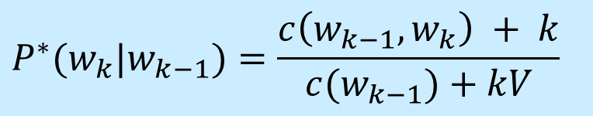
N-Gram Language Models
Add-K Smoothing
Good-Turing Smoothing
A Fractional Count k (e.g., 0.5, 0.05, or 0.01)
$$P^{∗}(w_{k}|w_{k−1})=\frac{c\left(w_{k−1},w_{k}\right) + k}{c(w_{k−1})+kV}$$
Although add-k is useful for some tasks (including text classification), it turns out that it still doesn’t work well for language modeling.
Notes:
P51:
Note that add-one smoothing has made a very big change to the counts. C(want to) changed from 609 to 238! We can see this in probability space as well: P(tojwant) decreases from .66 in the unsmoothed case to .26 in the smoothed case. … The sharp change in counts and probabilities occurs because too much probabilIty mass is moved to all the zeros.
One alternative to add-one smoothing is to move a bit less of the probability mass from the seen to the unseen events. Instead of adding 1 to each count, we add a fractional count k (.5? .05? .01?). This algorithm is therefore called add-k smoothing. Although add-k is useful for some tasks (including text classification), it turns out that it still doesn’t work well for language modeling, generating counts with poor variances and often inappropriate discounts.

Slide 30



N-Gram Language Models
Backoff and Interpolation
Idea of Backoff
In backoff, we use the Tri-gram if the evidence is sufficient, otherwise we use the Bi-gram, otherwise the Uni-gram. In other words, we only “back off” to a lower-order N-gram if we have zero evidence for a higher-order N-gram.
$$P(w_{k}|w_{k−2},w_{k−1})$$
= 0
Tri-Gram Probability
≈
$$P(w_{k}|w_{k−1})$$
= 0
≈
$$P(w_{k})$$
Bi-Gram Probability
Uni-Gram Probability
Notes:
P51:
The discounting we have been discussing so far can help solve the problem of zero frequency n-grams. But there is an additional source of knowledge we can draw on. If we are trying to compute but we have no examples of a particular trigram, we can instead estimate its probability by using the bigram probability.
In backoff, we use the trigram if the evidence is sufficient, otherwise we use the bigram, otherwise the unigram. In other words, we only “back off” to a lower-order n-gram if we have zero evidence for a higher-order n-gram. By contrast, in interpolation, we always mix the probability estimates from all the n-gram estimators, weighing and combining the trigram, bigram, and unigram counts.
In order for a backoff model to give a correct probability distribution, we have to discount the higher-order n-grams to save some probability mass for the lower order n-grams. Just as with add-one smoothing, if the higher-order n-grams aren’t discounted and we just used the undiscounted MLE probability, then as soon as we replaced an n-gram which has zero probability with a lower-order n-gram, we would be adding probability mass, and the total probability assigned to all possible strings by the language model would be greater than 1!
This kind of backoff with discounting is also called Katz backoff.
Katz backoff is often combined with a smoothing method called Good-Turing. The combined Good-Turing backoff algorithm involves quite detailed computation for estimating the Good-Turing smoothing and the P and a values.

Slide 31
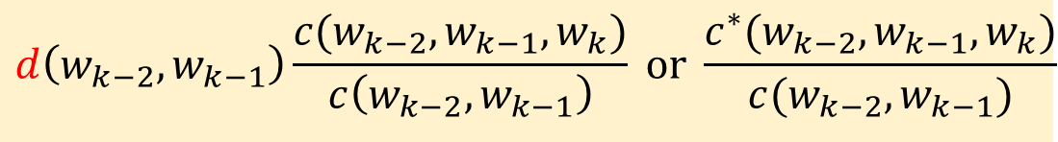


N-Gram Language Models
Backoff and Interpolation
Katz Backoff: Backoff with Discounting
Discounted Probability
$$d\left(w_{k−2},w_{k−1}\right)\frac{c(w_{k−2},w_{k−1},w_{k})}{c\left(w_{k−2},w_{k−1}\right)} or \frac{c^{∗}(w_{k−2},w_{k−1},w_{k})}{c(w_{k−2},w_{k−1})}$$
$$If c\left(w_{k−2},w_{k−1},w_{k}\right)>0$$
$$P_{BO}\left(w_{k} | w_{k−2},w_{k−1}\right)=\left\{\begin{aligned}P^{∗}\left(w_{k} | w_{k−2},w_{k−1}\right) \\ α\left(w_{k−2},w_{k−1}\right)P_{BO}\left(w_{k} | w_{k−1}\right)\end{aligned}\right.$$
$$Otherwise$$
Back-off Weight
Katz backoff is often combined with a smoothing method called Good-Turing.
Notes:
P51:
The discounting we have been discussing so far can help solve the problem of zero frequency n-grams. But there is an additional source of knowledge we can draw on. If we are trying to compute but we have no examples of a particular trigram, we can instead estimate its probability by using the bigram probability.
In backoff, we use the trigram if the evidence is sufficient, otherwise we use the bigram, otherwise the unigram. In other words, we only “back off” to a lower-order n-gram if we have zero evidence for a higher-order n-gram. By contrast, in interpolation, we always mix the probability estimates from all the n-gram estimators, weighing and combining the trigram, bigram, and unigram counts.
In order for a backoff model to give a correct probability distribution, we have to discount the higher-order n-grams to save some probability mass for the lower order n-grams. Just as with add-one smoothing, if the higher-order n-grams aren’t discounted and we just used the undiscounted MLE probability, then as soon as we replaced an n-gram which has zero probability with a lower-order n-gram, we would be adding probability mass, and the total probability assigned to all possible strings by the language model would be greater than 1!
This kind of backoff with discounting is also called Katz backoff.
Katz backoff is often combined with a smoothing method called Good-Turing. The combined Good-Turing backoff algorithm involves quite detailed computation for estimating the Good-Turing smoothing and the P and a values.

Slide 32
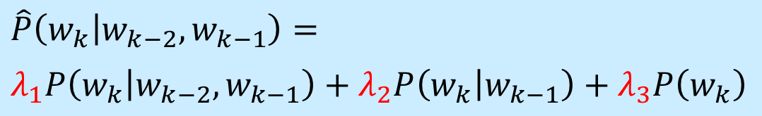
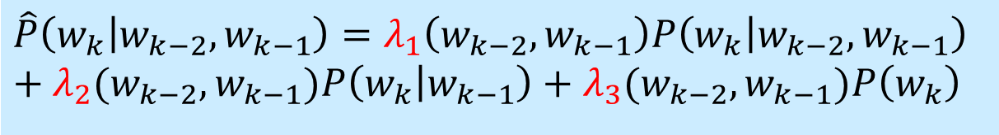

N-Gram Language Models
Backoff and Interpolation
Idea of Linear Interpolation
By contrast, in interpolation, we always mix the probability estimates from all the N-gram estimators, weighing and combining the Tri-gram, Bi-gram, and Uni-gram counts.
$$\hat{P}\left(w_{k} | w_{k−2},w_{k−1}\right)=$$
$$λ_{1}P\left(w_{k} | w_{k−2},w_{k−1}\right)+λ_{2}P\left(w_{k} | w_{k−1}\right)+λ_{3}P\left(w_{k}\right)$$
$${(λ}_{1}+λ_{2}+λ_{3}=1)$$
Context-Independent
$$\hat{P}\left(w_{k} | w_{k−2},w_{k−1}\right)=λ_{1}\left(w_{k−2},w_{k−1}\right)P\left(w_{k} | w_{k−2},w_{k−1}\right)$$
$$+{ λ}_{2}(w_{k−2},w_{k−1})P\left(w_{k} | w_{k−1}\right)+λ_{3}{(w}_{k−2},w_{k−1})P\left(w_{k}\right)$$
Context-Dependent

Slide 33
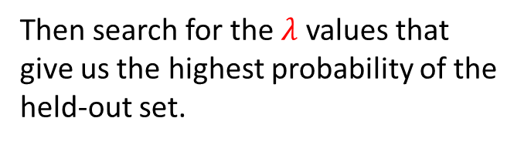
N-Gram Language Models
Backoff and Interpolation
Interpolation works better.
Training
Data
Held-Out
Data
Test Data
Fix the N-gram probabilities on the training data.
Then search for the $λ$ values that give us the highest probability of the held-out set.
One way is to use the Expectation-Maximization (EM) algorithm, an iterative learning algorithm that converges on locally optimal λs.
Notes:
Interpolation [ɪnˌtɚpəˈleɪʃən] works better.
P51:
The discounting we have been discussing so far can help solve the problem of zero frequency n-grams. But there is an additional source of knowledge we can draw on. If we are trying to compute but we have no examples of a particular trigram, we can instead estimate its probability by using the bigram probability.
In backoff, we use the trigram if the evidence is sufficient, otherwise we use the bigram, otherwise the unigram. In other words, we only “back off” to a lower-order n-gram if we have zero evidence for a higher-order n-gram. By contrast, in interpolation, we always mix the probability estimates from all the n-gram estimators, weighing and combining the trigram, bigram, and unigram counts.

Slide 34
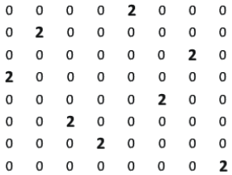

N-Gram Language Models
Unknown Word (Out of Vocabulary (OOV)) Problem
Question: What about words we have never see before?
There is no way back!
Data Sparseness (N-Gram)
Unknown Word (Uni-Gram)
Notes:
cannot be backed off any further!

Slide 35
N-Gram Language Models
Unknown Word (Out of Vocabulary (OOV)) Problem
Closed Vocabulary vs. Open Vocabulary
Closed Vocabulary: If we know all the words in advanced, vocabulary V is fixed, and there will be no unknown words in the test set.
Open Vocabulary: Often we don’t know this and will call those unknown words out of vocabulary (OOV) words.
An open vocabulary system is the one in which we model these potential unknown words in the test data by adding a pseudo-word called <UNK> in the training data.
Notes:
Closed Vocabulary vs. Open Vocabulary
P41:
Sometimes we have a language task in which this can’t happen because we know closed all the words that can occur. In such a closed vocabulary system the test set can only contain words from this known lexicon, and there will be no unknown words.
In most real situations, however, we have to deal with words we haven’t seen before, which we’ll call unknown words, or out of vocabulary (OOV) words. The percentage of OOV words that appear in the test set is called the OOV rate. One way to create an open vocabulary system is to model these potential unknown words in the test set by adding a pseudo-word called <UNK>.
An open vocabulary system is one in which we model these potential unknown words in the test set by adding a pseudo-word called <UNK>.

Slide 36
N-Gram Language Models
Unknown Word (Out of Vocabulary (OOV)) Problem
There are two common ways to train the probabilities of the unknown word models.
(1) Choose a vocabulary; Convert in the training set any word that is not in this set to <UNK>; Estimate the probabilities for <UNK> from its counts just like any other regular word in the training set.
(2) We don’t have a prior vocabulary in advance, but replace words in the training data by <UNK> based on their (low) frequency.
Notes:
P41:
The second alternative, in situations where we don’t have a prior vocabulary in advance, is to create such a vocabulary implicitly, replacing words in the training data by <UNK> based on their frequency.

Slide 37
N-Gram Language Models
Unknown Word (Out of Vocabulary (OOV)) Problem
Note that the exact choice of <UNK> model does have an effect on metrics like perplexity. A language model can achieve low perplexity by choosing a small vocabulary and assigning the unknown word a high probability.
For this reason, perplexities should only be compared across language models with the same vocabularies.
Notes:
P41:
The second alternative, in situations where we don’t have a prior vocabulary in advance, is to create such a vocabulary implicitly, replacing words in the training data by <UNK> based on their frequency.

Slide 38
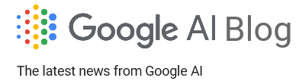

N-Gram Language Models
Language Modeling Toolkits
SRILM: http://www.speech.sri.com/projects/srilm/
KenLM: https://kheafield.com/code/kenlm/
Google N-Gram Release (August, 2006)

Slide 39
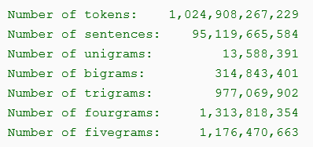
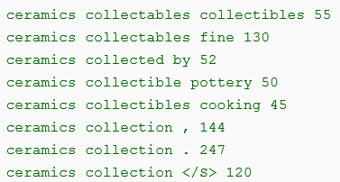
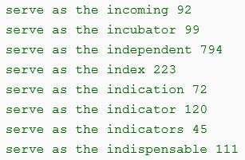
N-Gram Language Models
Google N-Gram Release (August, 2006)
Example of 3-Grams
Example of 4-Grams
Notes:
P41:
The second alternative, in situations where we don’t have a prior vocabulary in advance, is to create such a vocabulary implicitly, replacing words in the training data by <UNK> based on their frequency.

Slide 40
N-Gram Language Models
Google N-Gram Release (August, 2006)
Example of 3-Grams
Example of 4-Grams

Slide 41
References
Book Chapters
Speech and Language Processing
Chapter 3: Language Modeling with N-Grams
Notes:
Pre-trained models for natural language processing: a survey, by Xipeng Qiu
Must-Read Papers on Pre-trained Language Models (PLMs) (for research students)
https://github.com/thunlp/PLMpapers
Pre-trained Language Model
https://leemeng.tw/attack_on_bert_transfer_learning_in_nlp.html
https://arxiv.org/abs/1810.04805

Slide 42


